Slide 1



Deep Learning in Advanced Driver Assistance Systems(ADAS): Innovations, Challenges, and Future Pathways
Submitted by: Prachi Agrawal KSU ID: 811363907 Course: Advanced Machine Learning (BA_64061_001)

Slide 2
Abstract & Scope
Presentation Overview
Review of deep learning fundamentals
Evolution and applications in ADAS
Cross‑industry case studies
Key limitations & research trends
Potential future developments

Slide 3
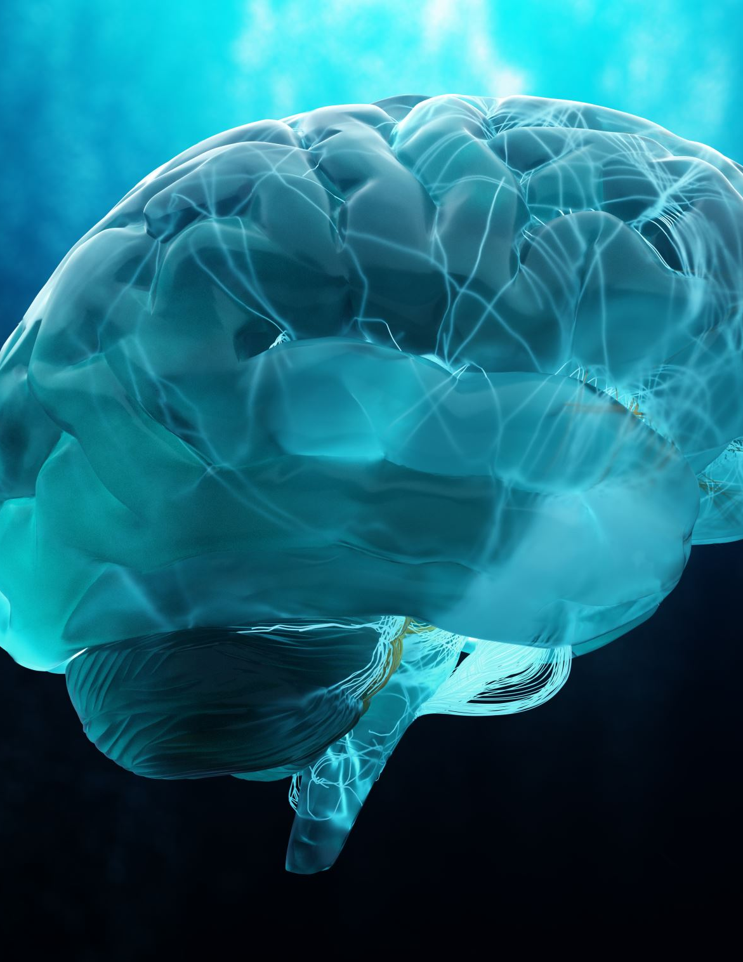
Introduction to Deep Learning
What is Deep Learning?
Inspired by the human brain
Learns from large volumes of data
Powers vision, speech, and decisions

Slide 4
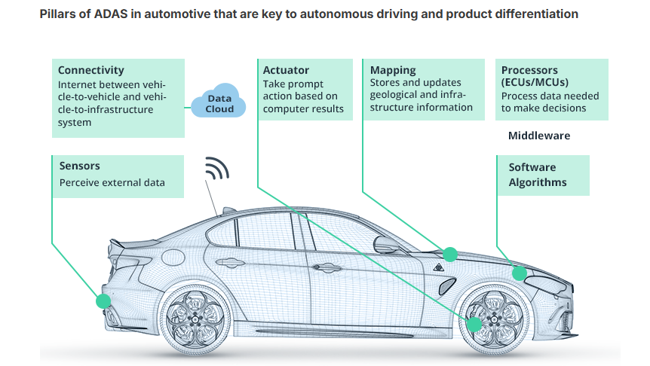
Overview of ADAS and Deep Learning
Advanced Driver Assistance Systems
Sensor networks: cameras, radar, LiDAR, ultrasonic
Real‑time data processing via deep learning
Functions: lane centering, collision avoidance, adaptive cruise

Slide 5
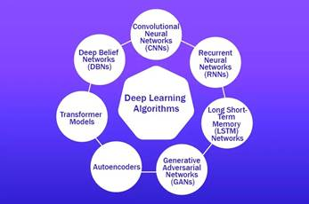
Core DL Techniques in ADAS
Deep Learning Models in ADAS
Convolutional Neural Networks (CNNs): object, lane, pedestrian detection
Recurrent Neural Networks (RNNs/LSTM): traffic flow & behavior prediction, in‑car speech
Generative Adversarial Networks (GANs): synthetic edge‑case data for robust training
Transformers & Attention: sensor fusion and context‑aware decisions

Slide 6
Industry Implementations
Tesla Autopilot: Vision‑only CNN + HydraNet + spatio‑temporal fusion
Waymo: LiDAR + radar fusion, VoxelNet, GNNs for behavior prediction
NVIDIA Drive AGX: CNNs, attention models, Omniverse simulation
Mobileye REM: Crowd‑sourced HD mapping, multi‑camera perception
Cruise: Deep RL for decision policies, multi‑sensor fusion in simulators

Slide 7
Cross‑Industry Case Studies
Beyond Automotive
Precision Agriculture: Autonomous weed detection & crop monitoring
Healthcare Diagnostics: CNNs & RNNs for patient outcome forecasting and histopathology
High‑Performance Computing: GPU/Cloud‑accelerated model training

Slide 8
Key Limitations
Challenges in Deploying DL Systems
Safety & Explainability: Black‑box models hinder trust
Data Requirements: Costly annotation, edge‑case scarcity
Inference Latency: Real‑time bottlenecks on embedded hardware
Adversarial Attacks: Vulnerability to input perturbations
Domain Generalization: Overfitting to training conditions

Slide 9
Current Research
Advancing ADAS through Research
Explainable Multi‑Sensor Fusion: Real‑time interpretability
Adversarial Defense: Robust training and certification
Domain Adaptation: Transfer learning for new environments
Edge‑Optimized Models: Pruning, quantization for fast inference

Slide 10

Future Directions
The Road Ahead for DL in ADAS
End‑to‑End Architectures: Unified perception to control
V2X Connectivity: Vehicle‑to‑everything communication
Edge AI: Real‑time, on‑vehicle intelligence
Sustainable AI: Energy‑efficient algorithms for EVs
Ethical & Regulatory Frameworks: Standardization for safety

Slide 11
Conclusion
Key Takeaways
Deep learning is central to ADAS innovation
Cross‑industry applications demonstrate its versatility
Addressing limitations is paramount for safe deployment

Slide 12
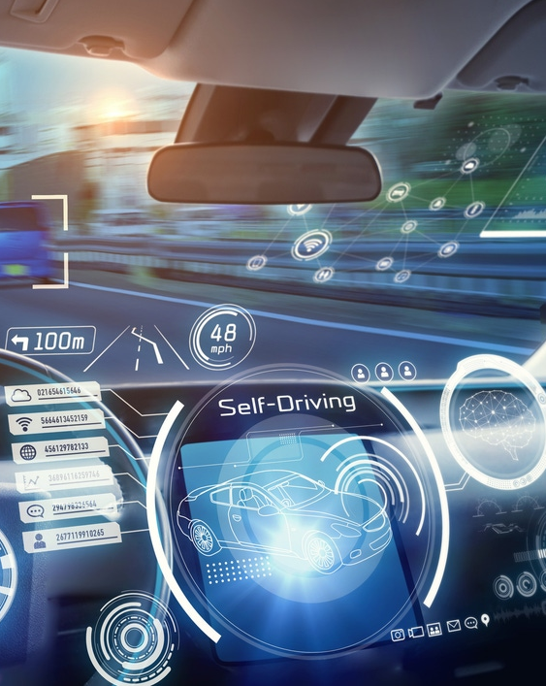
Thank You!

